Slide 1
UIT2502 - Data Analytics and Visualization Lab
Energy Consumption and Optimization
Sri Sai Ankit (3122215002118)
Vasundhara B (3122215002119)
Vemula Muni Karthik (3122215002120)

Slide 2
Problem statement
Inefficient energy consumption in property area facilities poses a significant challenge. Leveraging data science techniques, our project aims to monitor and analyze energy usage patterns, providing actionable insights for optimizing consumption, reducing costs, and advancing sustainability efforts. The goal is to develop a comprehensive solution that enhances operational efficiency while aligning with environmental sustainability objectives

Slide 3
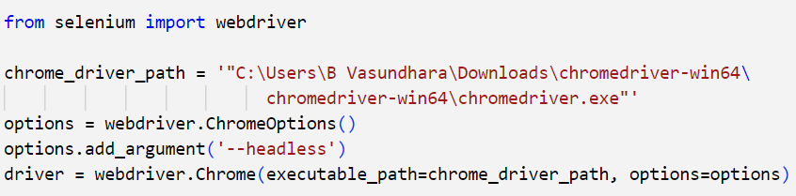
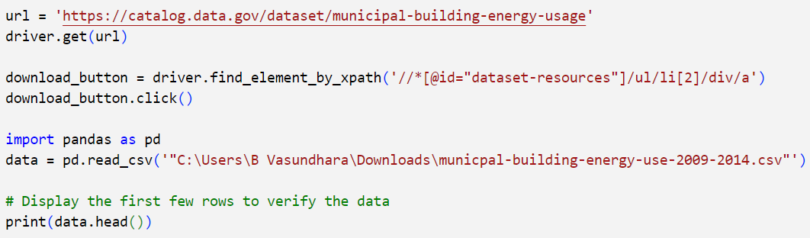
Data Collection
Code Snippets:
Objective: To retrieve building energy usage data
Method Used: Employed Selenium for automated web scraping.
Website: https://catalog.data.gov/dataset/municipal-building-energy-usage
Regular updates to the code and monitoring of website changes necessary for maintaining accuracy and reliability.

Slide 4
Data Preprocessing
Identifying and take care of missing information by way of both removing or imputing missing values the usage of appropriate strategies.
Cleaning the data to address inconsistencies, mistakes, and duplicates that could have an effect on the analysis.
Identifying and address outliers that skew analysis and negatively affect model training.
Using statistical methods or domain knowledge such as pruning or transforming data, to determine how to best handle outliers.

Slide 5
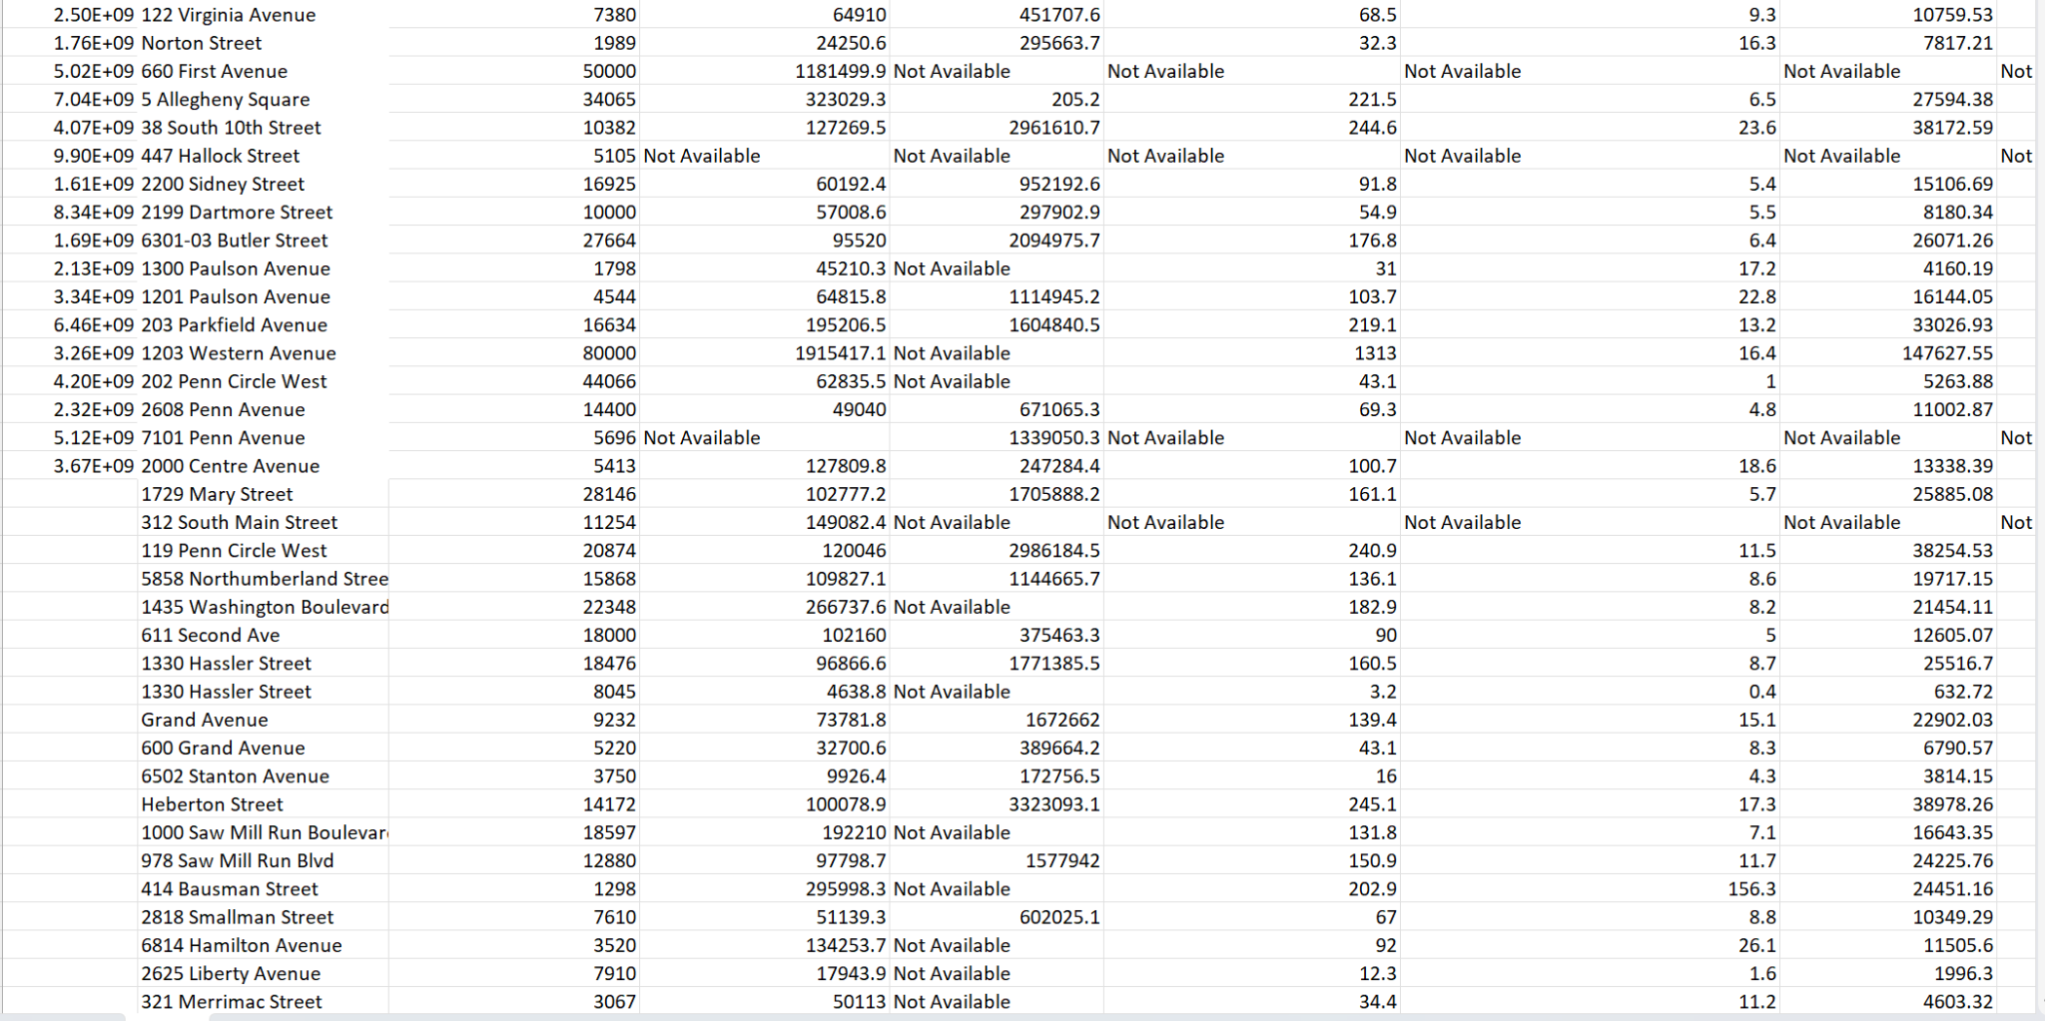
Data before preprocessing

Slide 6
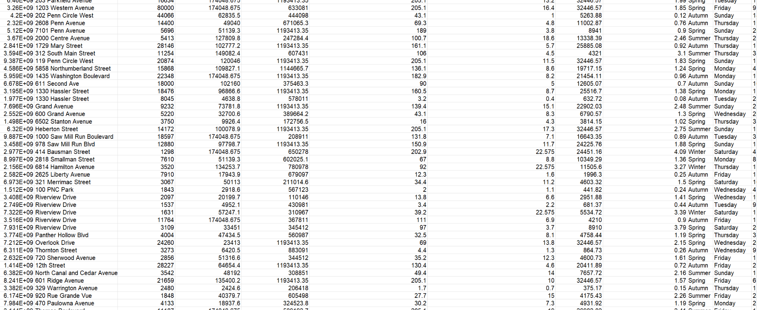
Data after Preprocessing

Slide 7
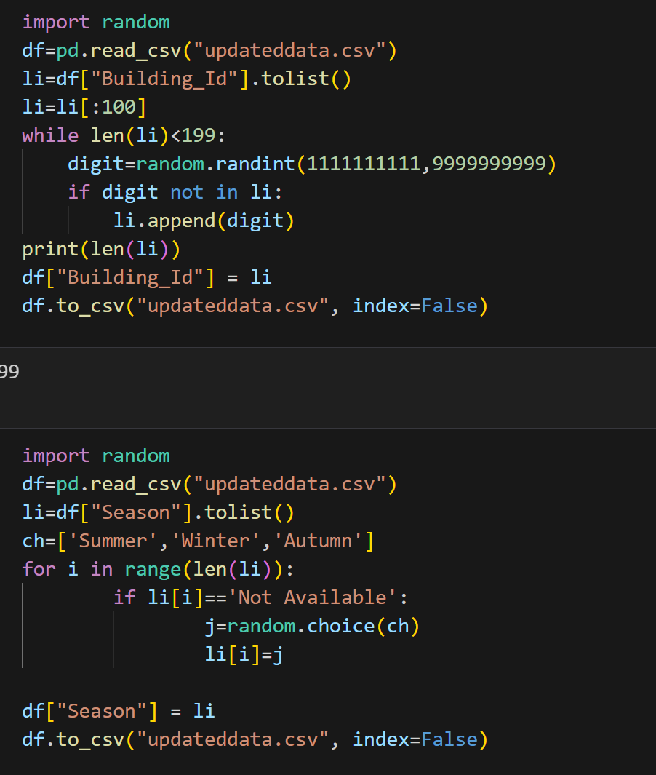
Code snippet for handling missing values

Slide 8
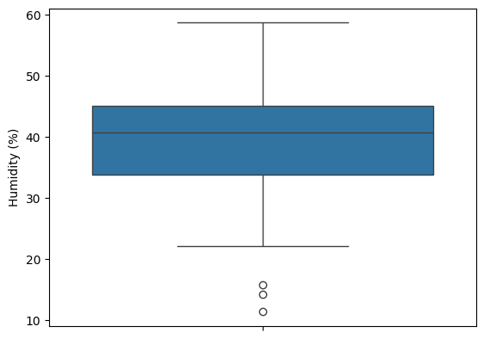
Outlier’s

Slide 9
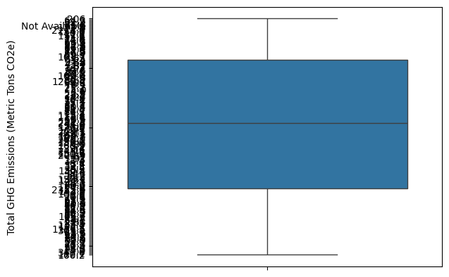
Outliers

Slide 10
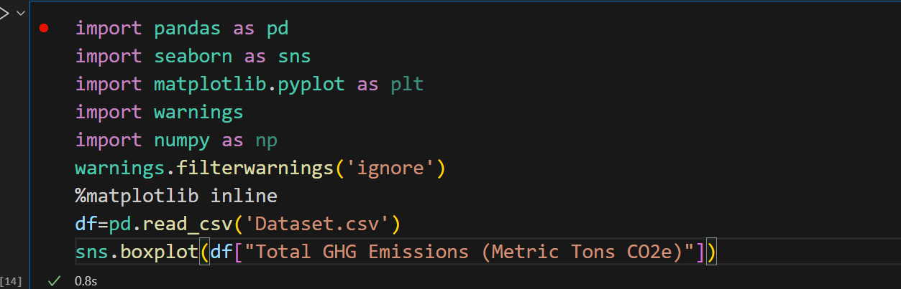
Code snippet for Boxplot

Slide 11
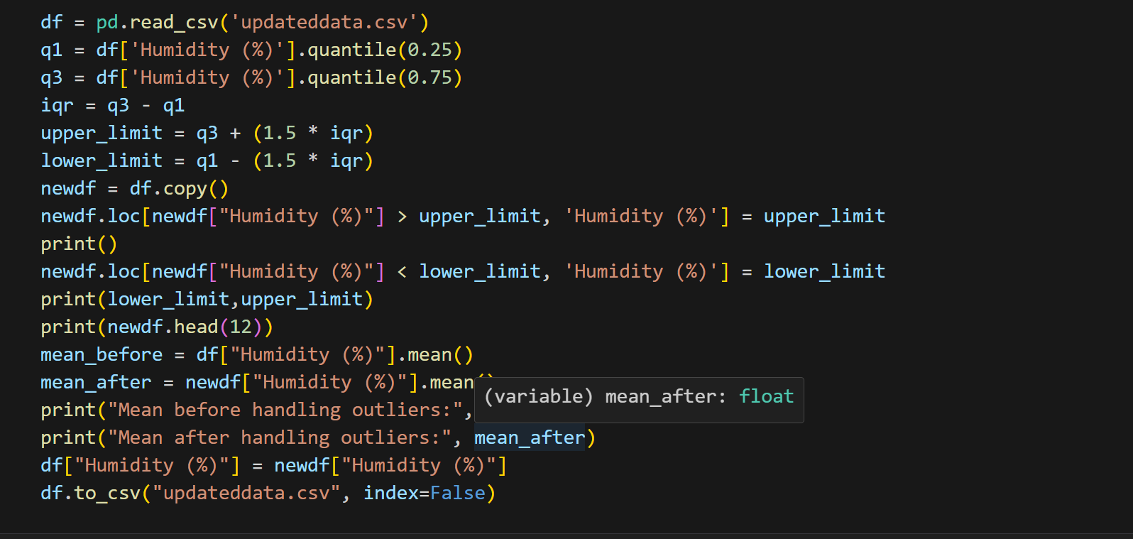
Code snippets for handling outliers

Slide 12
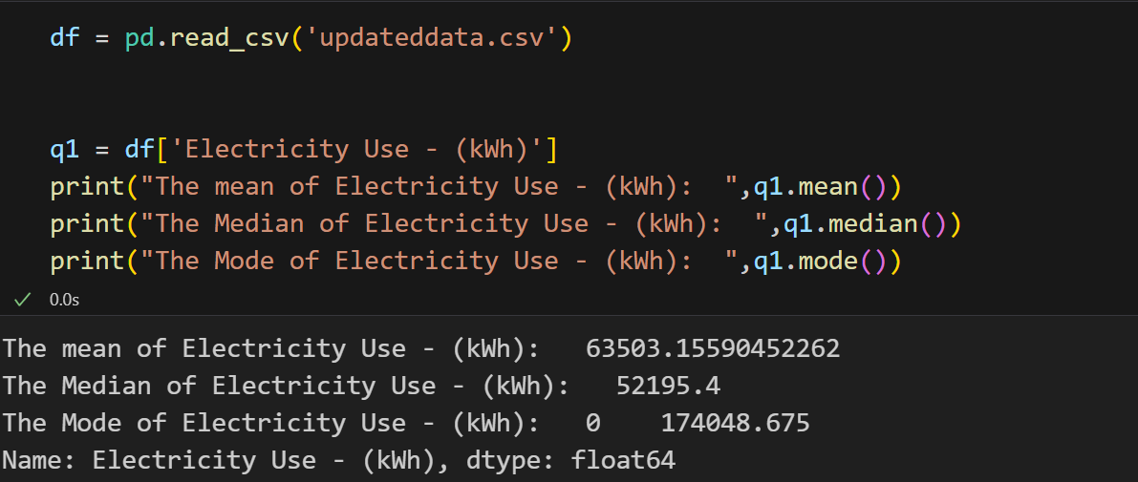
Mean, Median and Standard Deviation for data

Slide 13
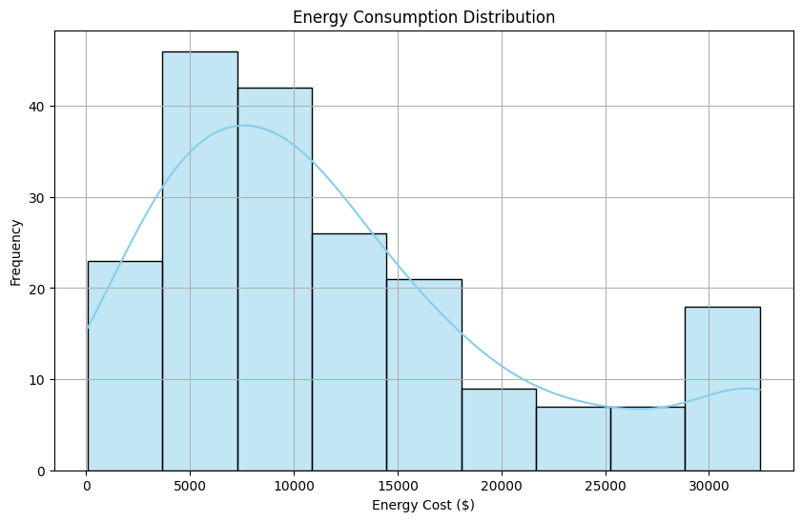
Frequency distribution

Slide 14
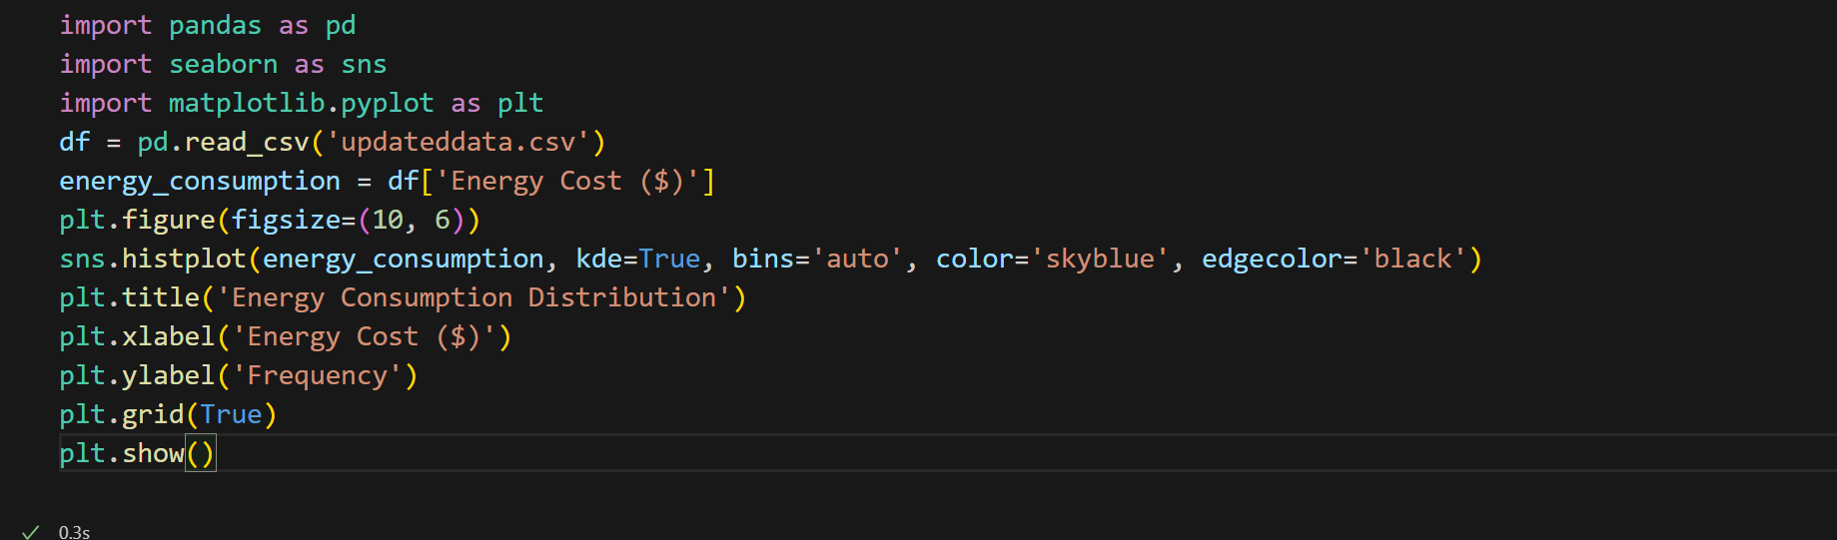
Code snippet

Slide 15
Implications of central tendency and variability
T
The model is aimed at monitoring and optimizing energy consumption, thus the central tendency of Energy Consumption of the population was taken into consideration
Here are the implications:
The mean being higher than the median suggests that the distribution of electricity consumption might be positively skewed, meaning there might be some extremely high values that are pulling the mean upwards.
The mode being significantly different from both the mean and median indicates that there's a specific value (174,048) that occurs most frequently in the dataset, while the majority of values might be lower.
The standard deviation of 48965 indicates that the electricity consumption values are very largely varied or distributed from the mean

Slide 16
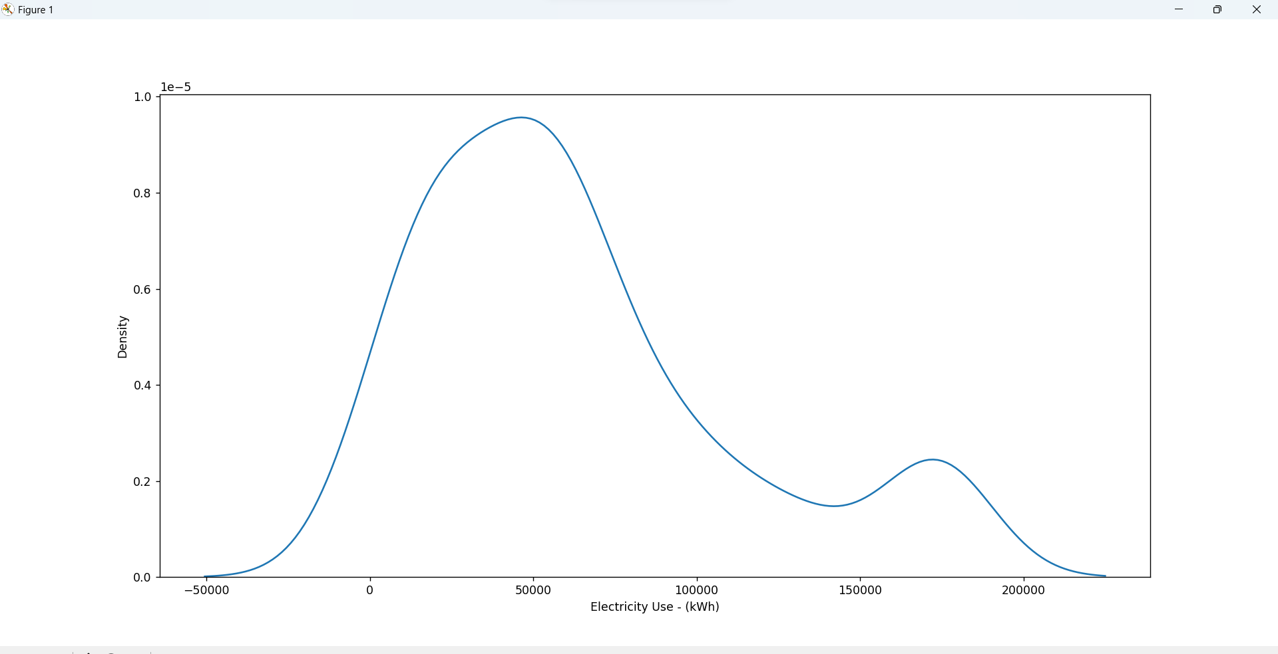
Normal Distribution
To check for normal distribution , seaborn module was used to draw the kernel density plot, if the plot resembles a bell like structure ,then the distribution of our data set is said to be normal

Slide 17
Correlation
Correlation refers to the relationship or association between two variables. It measures how changes in one variable are related to changes in another variable.
To analyze correlation, we require to compare independent variables and dependent variables, both being of numerical data type
The independent variables taken for consideration were Property Area (ft²), Natural Gas Use (kBtu), Total GHG Emissions (Metric Tons CO2e),Energy Cost ($), Temperature, Humidity (%),No. of Occupants
The dependant variable taken was Electricity use as our primary objective is to monitor the electricity consumption and optimize based on the factors that affect it

Slide 18
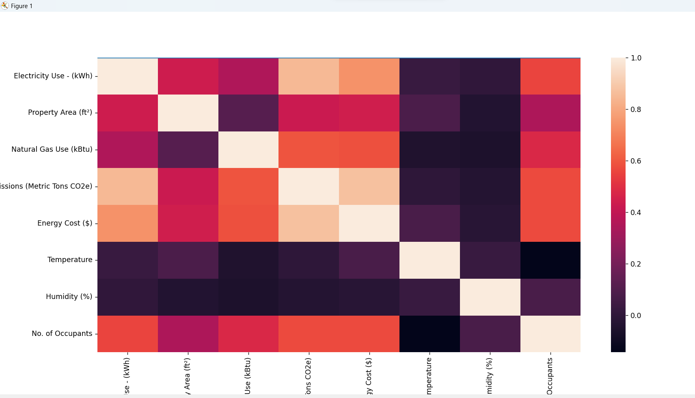
Correlation matrix

Slide 19
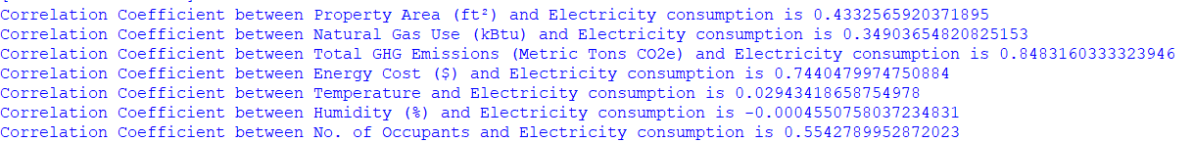
The correlation matrix was generated and the following are the calculated correlation coefficients:
From the above we can infer that:
Property area and Electricity consumption share a INTERMEDIATE DIRECT RELATIONSHIP i.e as property area increases, electricity consumption also increases by moderate amount
Total GHG Emissions and Electricity consumption share a STRONG DIRECT RELATIONSHIP i.e increase in ghg emissions imply an increase in electricity consumption
Humidity and Electricity consumption share a WEAK INDIRECT RELATIONSHIP i.e as humidity decreases, electricity consumption increases by a small amount

Slide 20
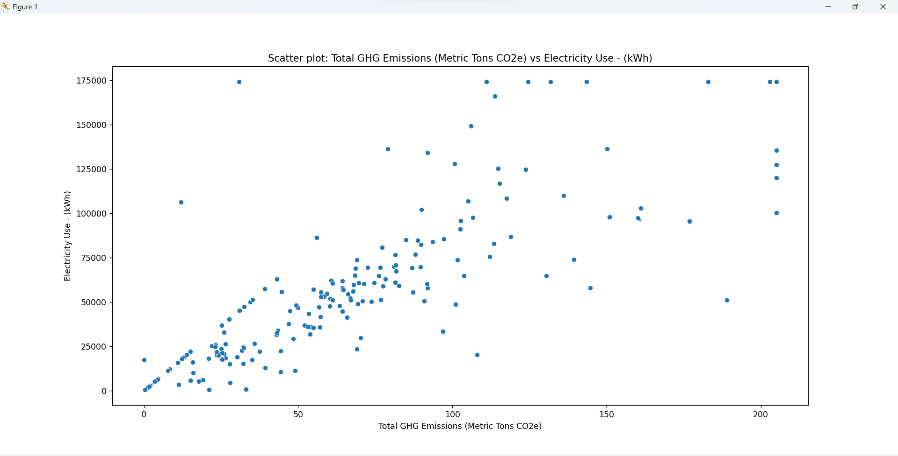
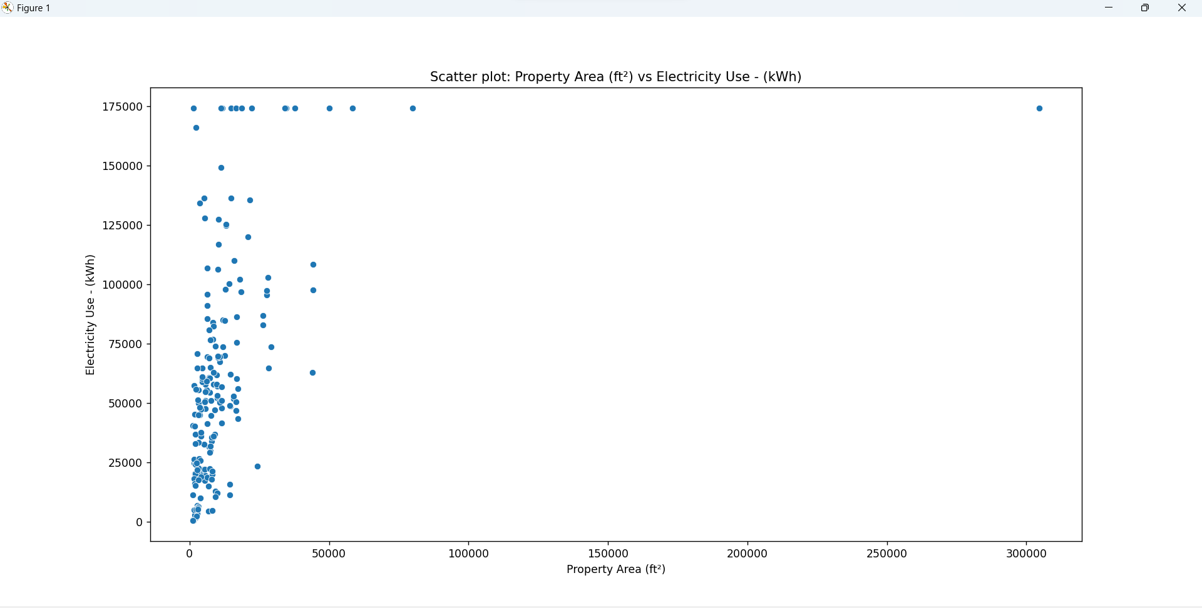
Scatter plots
A linear strong relationship between ghg emissions and electricity consumption
A weak linear relationship between property area and electricity consumption

Slide 21
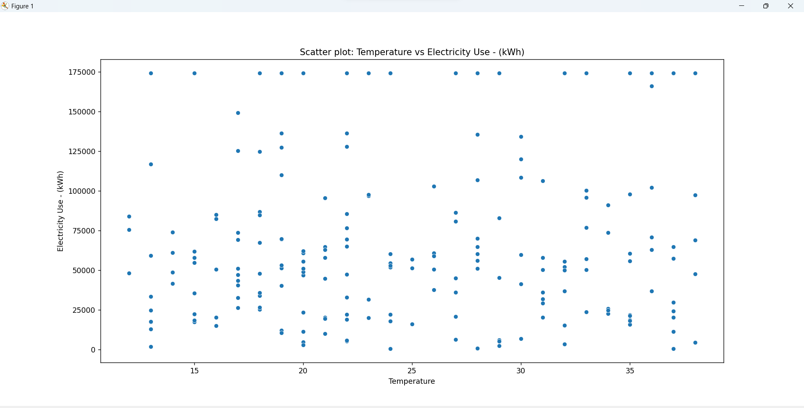
No significant relationship between temperature and Electricity consumption

Slide 22
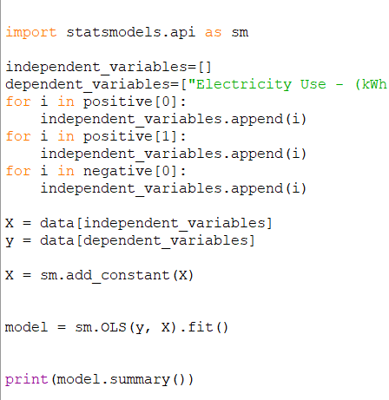
Regression
Regression is a statistical method used to understand and quantify the relationship between two or more variables. It helps in predicting or estimating the value of one variable based on the values of other related variables.
The process of fitting chosen regression model to data

Slide 23
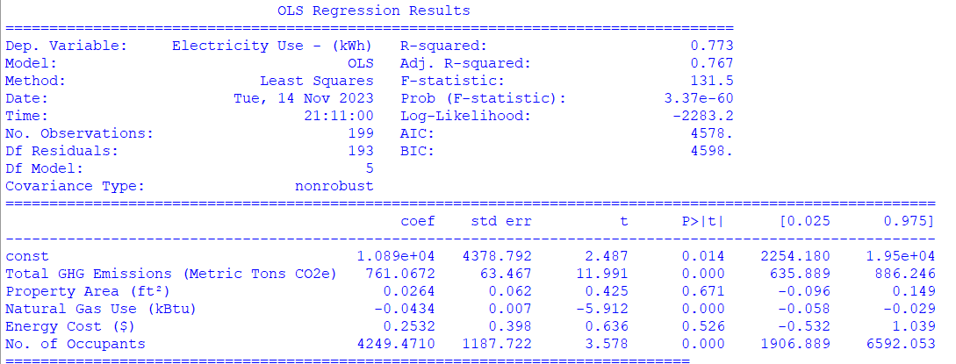
Inference based on regression analysis
Total GHG Emissions: Significant positive impact on the Energy consumption
Property Area: Insignificant impact on the Energy consumption
Natural Gas Use: Significant negative impact on the Energy consumption
No. of Occupants: Significant positive impact on the Energy consumption

Slide 24
Limitations of regression model
1.Assumptions Violation: Regression assumes linearity, independence and normality of residuals. Violations of these assumptions might affect the accuracy of the model predictions.
2.Multicollinearity: High correlation among independent variables can lead to multicollinearity issues, making it challenging to distinguish the individual effects of predictors.
3.Outliers and Influential Points: Outliers or influential data points can disproportionately impact the regression model, affecting the coefficients and statistical significance.

Slide 25
Z TEST
A Z-test is a statistical method used to determine if there's a significant difference between a sample and a population or between two samples. It assesses whether the average of a sample differs significantly from the population mean or if two sample means are significantly different from each other.
Z test has been performed on the dataset to find if there is a significant difference in electricity consumption between residential and industrial buildings ,also to infer if there is any significant difference in energy consumption between buildings which uses electricity as energy source and solar as energy source. Z test has been considered because of larger sample size and the test has been performed at 5 percent significance level.

Slide 26
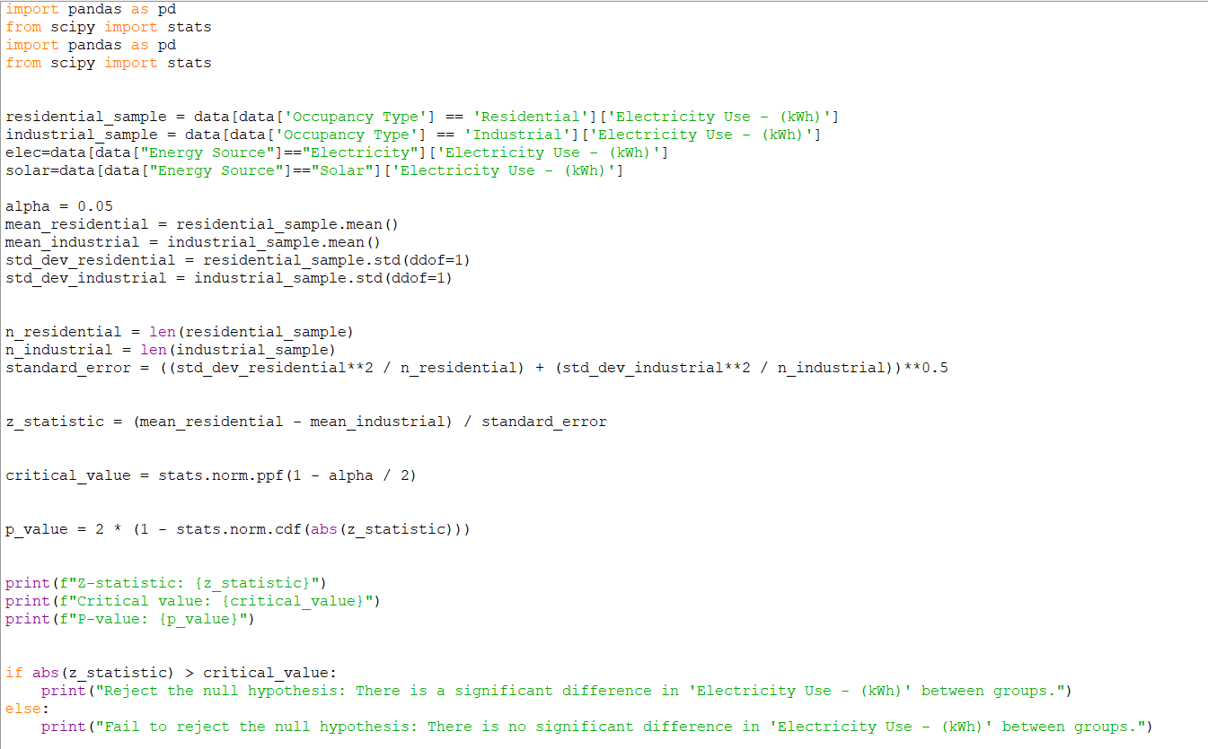
Application of Z test
Code Snippet:

Slide 27
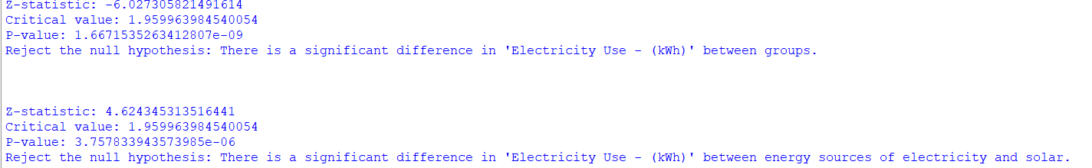
Inference from Z test
By performing the z test, we get the following results for the two independent groups
1)Industrial and Residential buildings: Z score is out of the 95 percent confidence interval, this implies that there is significant difference in Electricity consumption between both industrial and residential buildings
2)Electricity and Solar energy sources: Z score is out of the 95 percent confidence interval, this implies that there is significant difference in Electricity consumption between both Electricity and Solar energy sources

Slide 28
T test
A t-test is a statistical method used to compare the means of two groups and determine if they are significantly different from each other. It calculates the likelihood that the observed difference between the groups is due to chance or if it is a true difference.
A independent t test has been performed on the data set to infer if there is any difference in the energy consumption due to two different groups i.e different hvac system- Split or Central and different Seasons- Summer and Winter.
A t test has been performed because the sample size is taken is small
Assumption of t test is that data should be a normal distribution

Slide 29
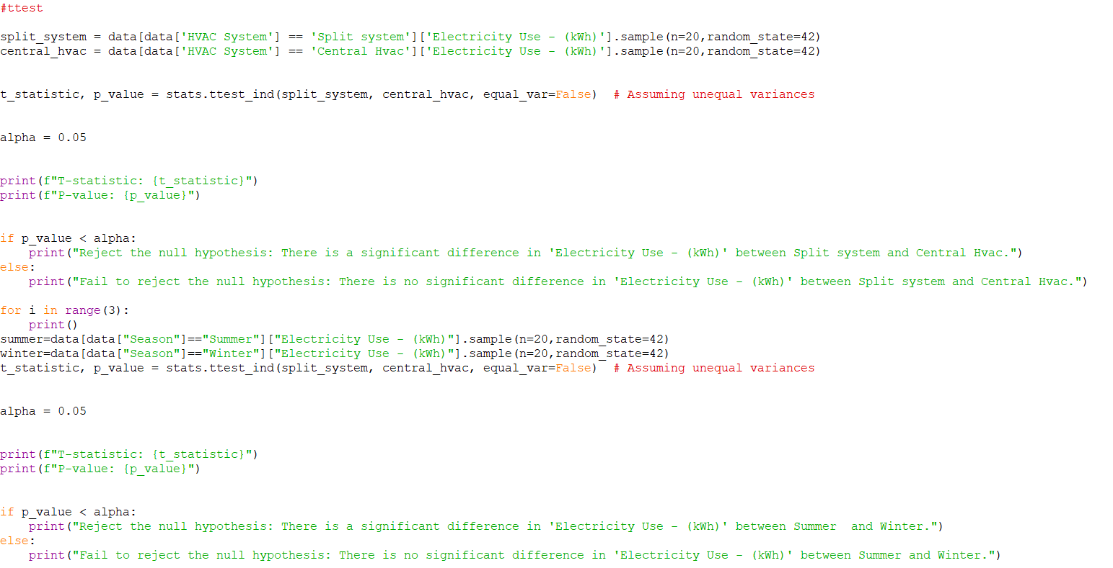
Application of t test
Code Snippet:

Slide 30
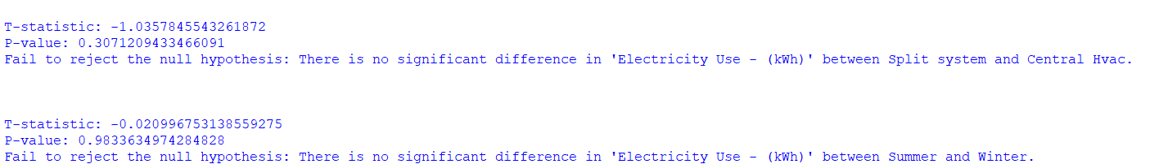
Inference from T test
By performing the t test we get the following results:
1)HVAC-Split System and Central Hvac: The t score is less than the p value, this implies that the null hypothesis of there being no significant difference in electricity consumption for both split system and hvac is accepted
2) Season- The t score is less than the p value, this again implies that the null hypothesis of there being no significant difference in electricity consumption for both summer and winter is accepted

Slide 31
ANOVA
ANOVA (Analysis of Variance) is a statistical test used to compare the means of three or more groups to determine if there are statistically significant differences among them. It helps to check whether the variations observed among the group means are likely due to actual differences in the groups or just due to random chance.
Assumption of ANOVA is that data should be a normal distribution
ANOVA is performed on the dataset to measure or infer the impact of CATEGORICAL INDEPENDENT VARIABLES on the dependant variable- Electricity Consumption
The independent categorical variables taken for consideration are: Season, Occupancy type, Energy Source and Day of Week.
Since there are more than 3 categorical variables ,we performed N way ANOVA

Slide 32
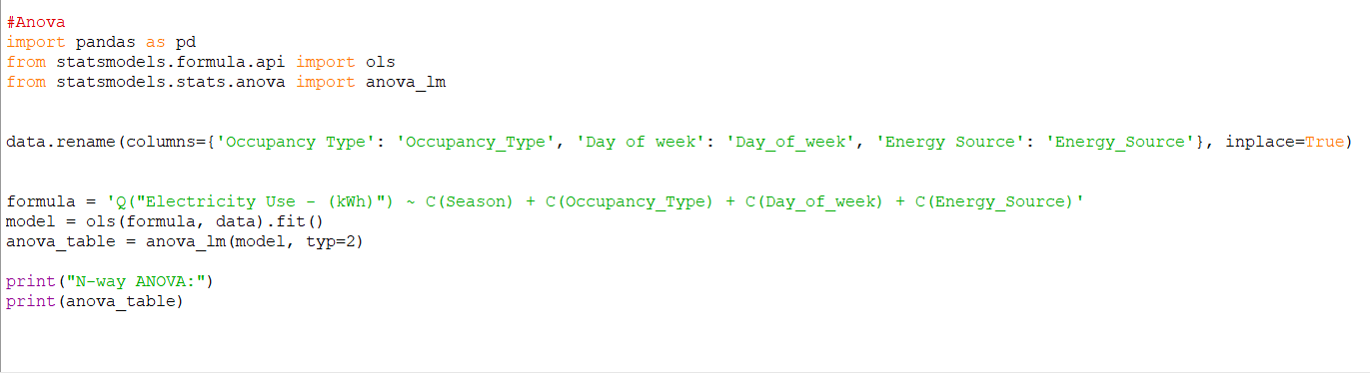
Application of ANOVA
Code Snippet:

Slide 33
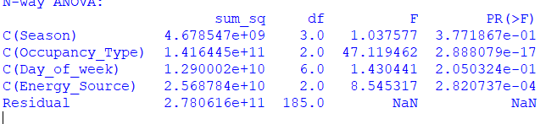
Inference from ANOVA TABLE
By performing Analysis of Variance we get the following results:
1)Season: The f statistic is less than the table f value, this implies that there is no significant impact of season on electricity consumption
2) Occupancy Type: The f statistic is greater than table f value, this implies that there is a significant impact of Occupancy type on electricity consumption
3) Day of Week: The f statistic is lesser than table f value, this implies that there is no significant impact of the day on which the recording was taken on the Electricity consumption
4)Energy Source: F statistic> Table f value. Thus there is impact of Energy source used on the electricity consumption

Slide 34
Building Linear Models
Model Construction Process:
Data Preparation: Cleaned, preprocessed, and organized the dataset.
Feature Selection: Identified significant predictors for the model.
(Independent variables - Property Area (ft²), Natural Gas Use (kBtu), Total GHG Emissions (Metric Tons CO2e),Energy Cost ($), Temperature, Humidity (%),No. of Occupants
Dependent variable - Electricity Use - (kWh))
Employed a linear regression algorithm to build the model.
Fitted the model to the data using technique Ordinary Least Squares (OLS).
Divided the dataset into training and testing sets to assess model performance.
Utilized metrics like R-squared, RMSE to gauge model accuracy.
Robustness Testing: Evaluated model performance on diverse datasets to check stability.

Slide 35
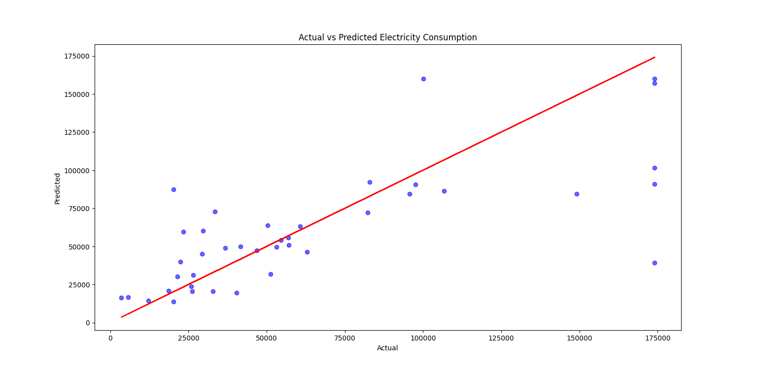
Validating Linear Models
Mean Squared Error (MSE): 1172100821.658663
R-squared: 0.5572870129373801
Linear Regression

Slide 36
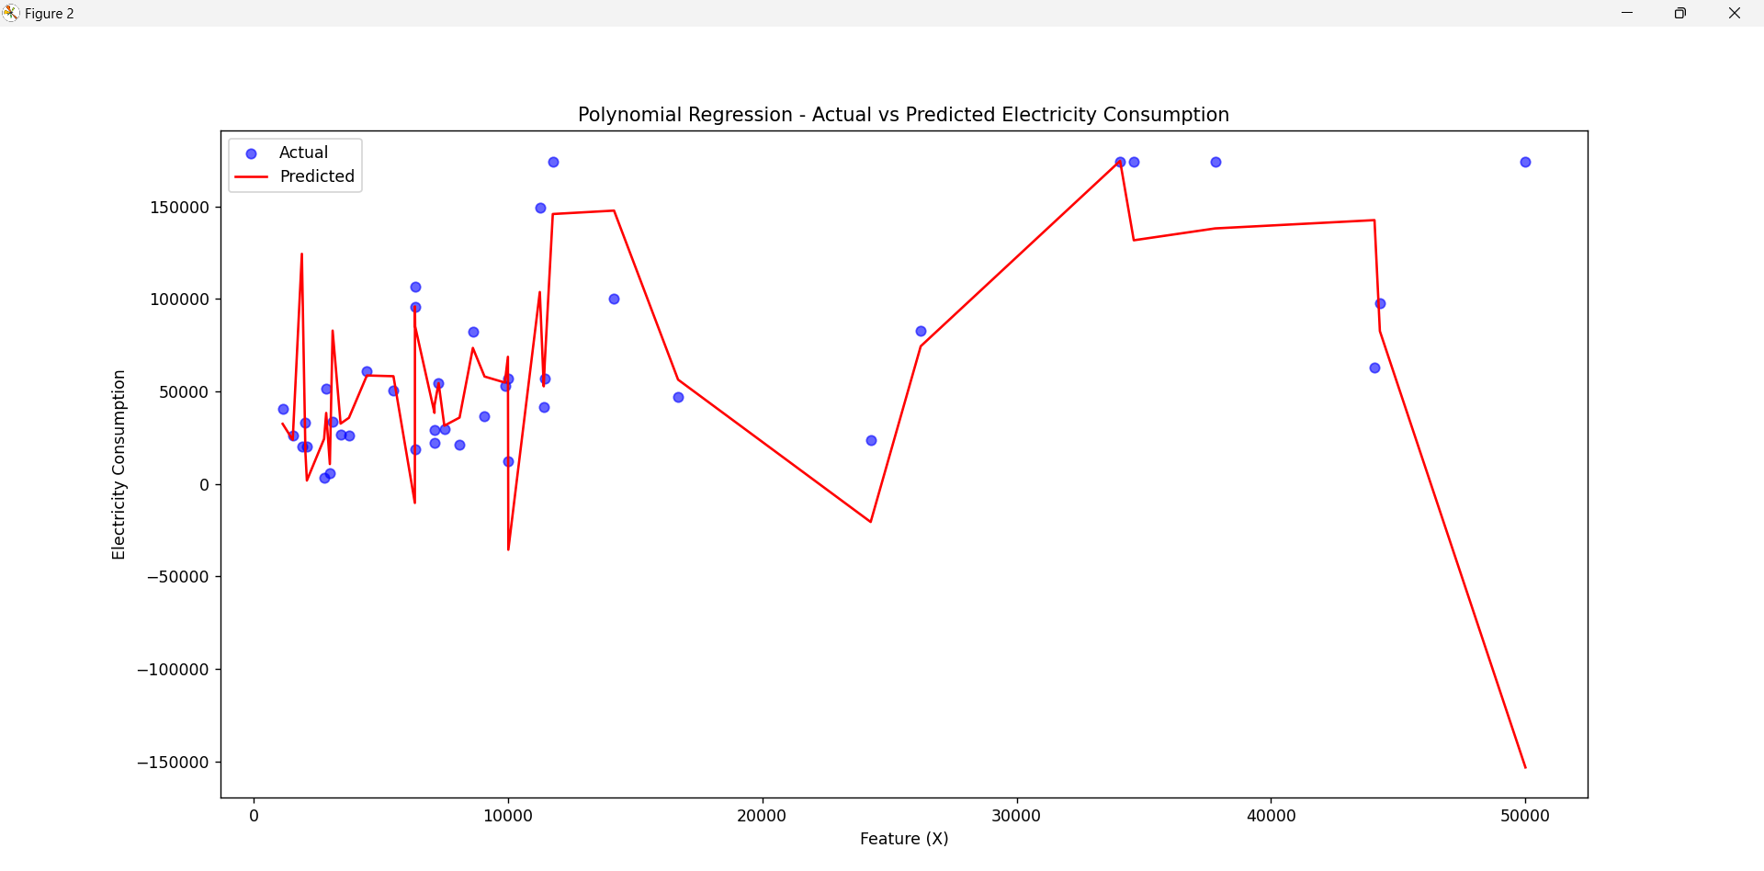
Validating Linear Models (cont)
Mean Squared Error (MSE): 3592118946.7179413
R-squared: -0.3567755259614087
Polynomial regression

Slide 37
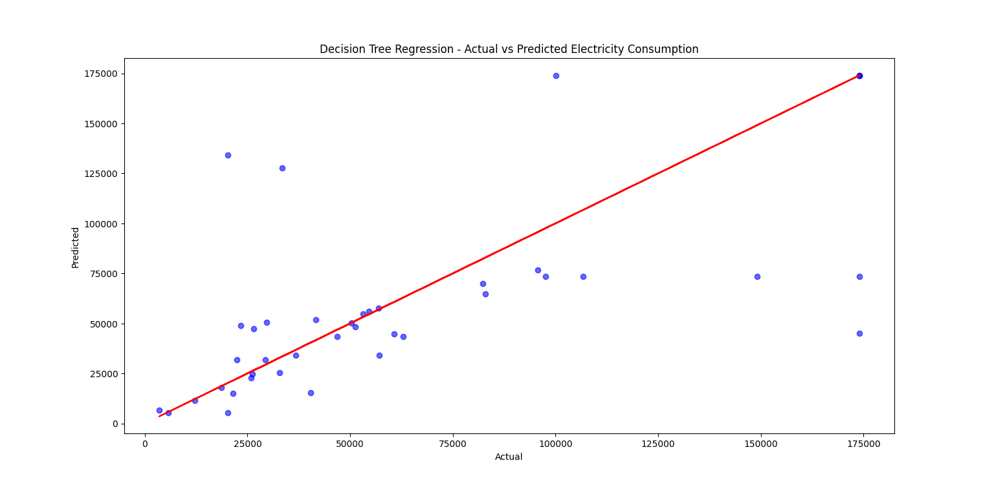
Validating Linear Models (Cont..)
Mean Squared Error (MSE): 1656270092.790547
R-squared: 0.37441193913323445

Slide 38
Inference from the regression models
The linear regression model gives a higher R square value, this implies that the linear regression model is better at explaining the variability of the target variable.
Also the mean square error is the sum of the squares of the difference of the predicted outputs with the mean. The smaller the difference ,the better is the regression model in predicting the values. Here linear regression model ha slowest mean square error, thus it can be said that it is the best fit model for the dataset.

